Slide 1
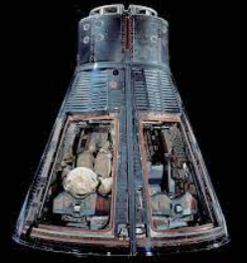
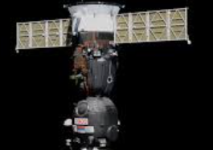

Astronauts
Víctor Hernández Denis
Yaritza Colon García
Fernando J Aponte Aponte
Alanis Barriera Rodriguez
Mario Signoret Rodriguez
John P Gallegos Matos

Slide 2
Background
On October 4, 1957, the Soviet Union launched the first artificial satellite into space. This milestone in human history propelled a race between the two most powerful post WWII nations to conquer space (Onion et al., 2020).
The two nations had to select the most capable and trained personnel in the shortest period of time(Collins, 2015; Rodríguez, 2019). The first astronauts were selected among the military forces for their piloting skills and their ability to undergo dangerous and physically demanding activities of these first expeditions(Lathers, 2019).
This first cadre of space travelers were composed exclusively of white men with military test pilot experience (NASA,2010). Up until 1978, NASA selected only white men.
From the early 1980s the interest in space in both, the United States and the Soviet Union, changed drastically. It was no longer a race to conquer it, but as a possible platform to conduct scientific experiments.
During the past 60 years, the demographic characteristics of the astronaut selection program and the types and durations of missions have changed. This has facilitated a more diverse group of space travelers with a variety of educational and scientific backgrounds.

Slide 3
Objective
This study aims to explore whether the demographic profile of the astronauts and the characteristics of space flight has changed systematically over time or not. For this task we analyzed a dataset of all 1,278 space mission flights from 1960 to 2018. The 24 variables included in this dataset describe the dates, mission, gender, education, experience (civilian or military), mission roles (pilot, payload specialist, mission specialist, etc.) date of selection and duration of all missions during the above-mentioned period.

Slide 4
Information about some astronaut groups
TsPK1 - pilot astronauts for the Vostok program
NASA Astronaut Group 1 – 1959 astronauts for Gemini program
NASA Astronaut Group 2 - pilots for the Gemini program and early Apollo missions. Nickname: The Next Nine
VVS Women - female astronauts for Vostok and Voskhod flights, primarily for propaganda purposes.

Slide 5
Total number of missions by sex
austronauts %>% group_by(sex) %>%
summarize(average = mean(total_number_of_missions), sta_dev = sd(total_number_of_missions))
Sex <chr> | Average <dbl> | Sta_dev <dbl>
Female | 2.993007 | 1.406707
male | 2.981481 | 1.400609

Slide 6
Graphs
The following parameters were analyed using the given database:
a) Proportion of astronauts v.s. gender
b) Top two nations with the most flights v.s. number of missions by gender
c) Year of the missions v.s. duration of the mission
d) Total hours per mission
e) Year of the mission v.s. nationality (median)
f) Year of the mission v.s. nationality
g)Sex of astronaut v.s. hours of mission
h) Demographic profile of astronauts
EVA = Extravehicular Activity

Slide 7
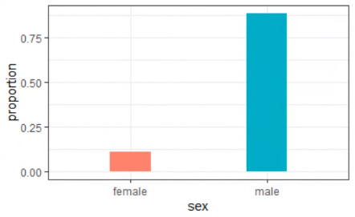
Proportion of astronauts v.s. gender
Diagram shows…
The difference in proportion for the astronauts of each gender for the past 60 years of space travel.
How the proportion of female astronauts is located below 0.25 while the male proportion is substantially higher in comparison being its proportion over 0.75.
How the male gender has predominated the space travel missions.
Code:
austronauts %>%
group_by(sex) %>%
summarize(proportion = n()/nrow(.)) %>%
ggplot(aes(sex, proportion, fill = sex)) +
geom_col(show.legend = FALSE, width = .3)

Slide 8
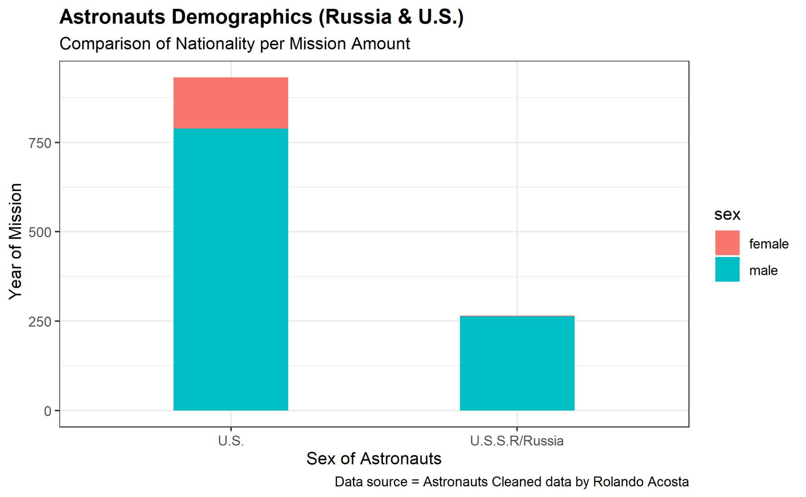
Top two nations with the most flights v.s. number of missions by gender
Diagram shows…
How the number of missions performed by the U.S. space program has a substantial lead on its Soviet counterpart.
The U.S.’s far lead in the total number of missions performed by a female crew.
Code:
filter(austronauts, nationality==c("U.S.S.R/Russia","U.S.")) %>%
group_by(nationality) %>%
ggplot(aes(nationality,mission_number, color = sex))+
geom_col(width = .4)

Slide 9
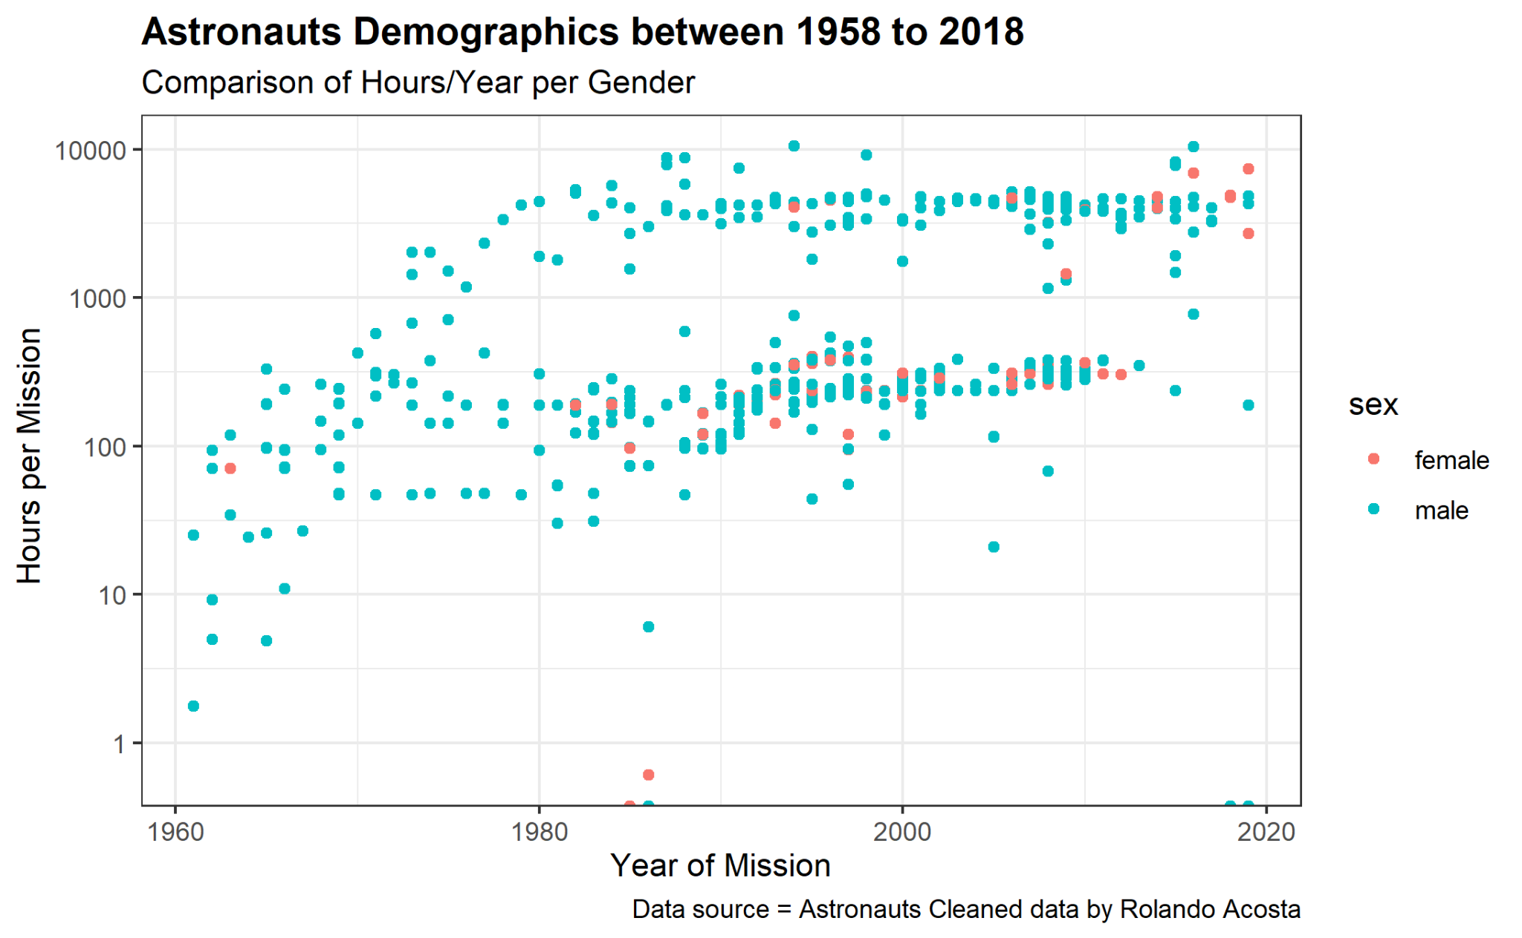
Year of each mission v.s. duration of each mission (in hours)
Diagram shows…
How the duration of each mission has extended a substantial amount during these past 60 years.
That the duration of a space travel mission during the 1960’ s was only over an hour.
How during the years the duration has changed being over 10 thousand hours in 2018.
How the inclusion of females in space travel missions have changed during the years.
Code:
austronauts %>%
ggplot(aes(x=year_of_mission,hours_mission,
color=sex))+
geom_point()+
scale_y_log10()

Slide 10
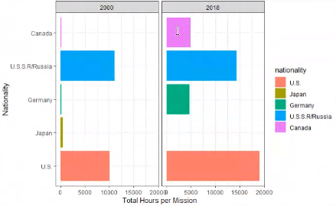
Total hours per mission
\
Diagram shows…
The total hours per mission during the 2000 and 2018 space travel missions with the nationality of the astronauts.
How the Soviets had the most hours during the 2000’s just a little over the U.S. followed by Japan and Canada and Germany.
How the total hours per mission doubled for every country.
Code:
austronauts %>%
drop_na() %>%
filter(year_of_mission %in% c(2000,2018) ) %>%
mutate(nationality=fct_reorder(nationality,hours_mission))
%>%
ggplot(aes(hours_mission,nationality, fill= nationality)) +
geom_col() +
facet_wrap(~year_of_mission) +
labs(y="Nationality",
x="Total Hours per Mission")

Slide 11
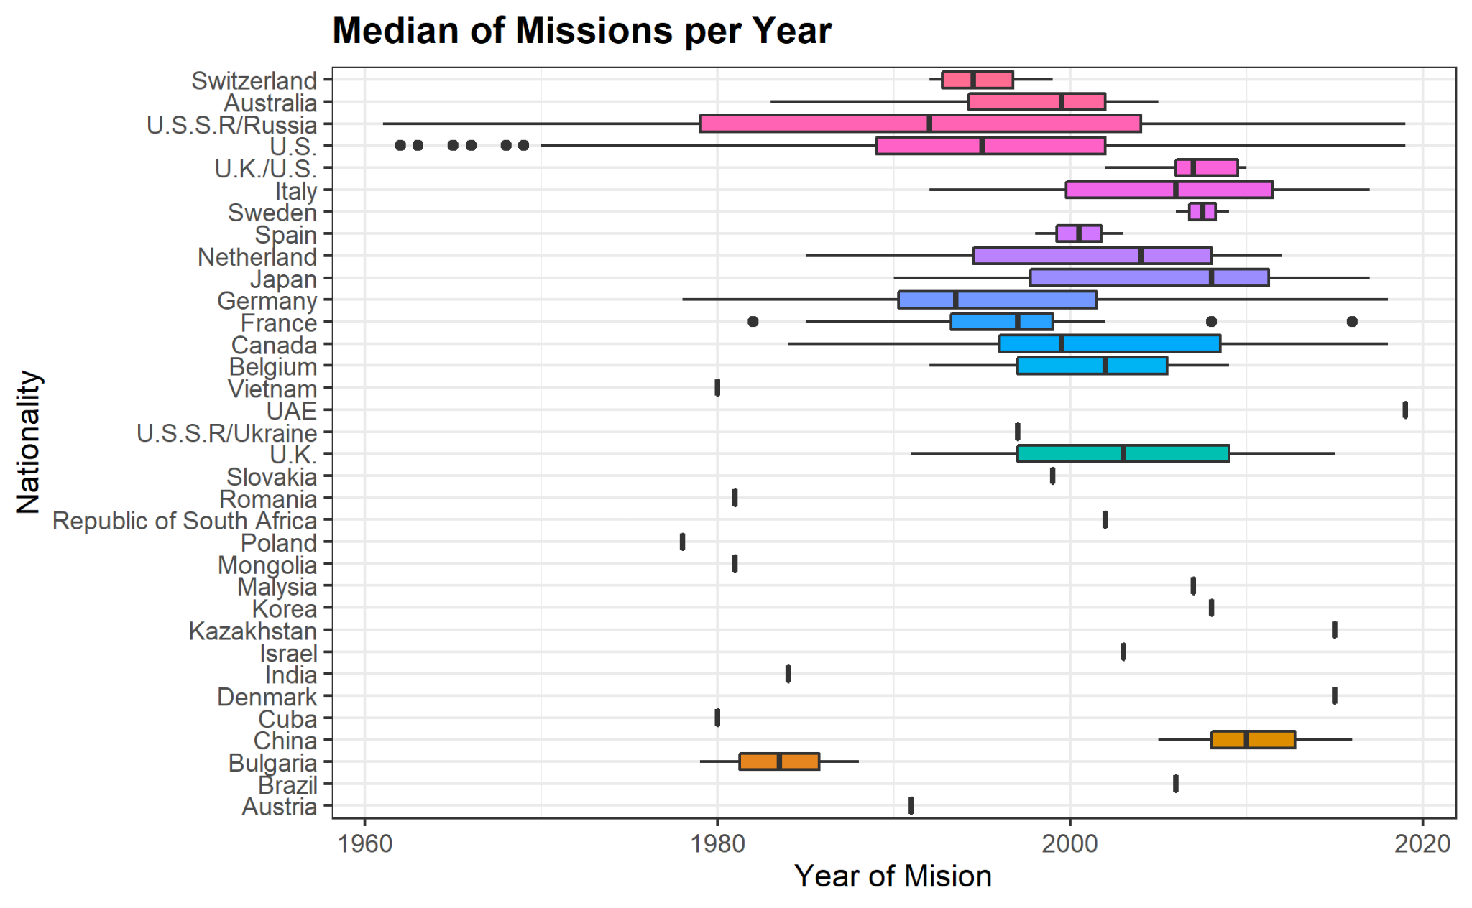
Year of the mission v.s. nationality
\
Diagram shows…
The median representation of each nation since the beginning of 1958 with the first flight.
That some nations don't represent a big impact in the graph since they just had 1 or in some cases 2 astronauts.
That other nations like the United States, Rusia, Japan, Germany and even Canada have a significant number of astronauts which imply their behavior for space research.
Code:
austronauts %>%
drop_na() %>%
filter(year_of_mission %in% c(2000,2018) ) %>%
mutate(nationality=fct_reorder(nationality,hours_mission))
%>%
ggplot(aes(hours_mission,nationality, fill= nationality)) +
geom_col() +
facet_wrap(~year_of_mission) +
labs(y="Nationality",
x="Total Hours per Mission")

Slide 12
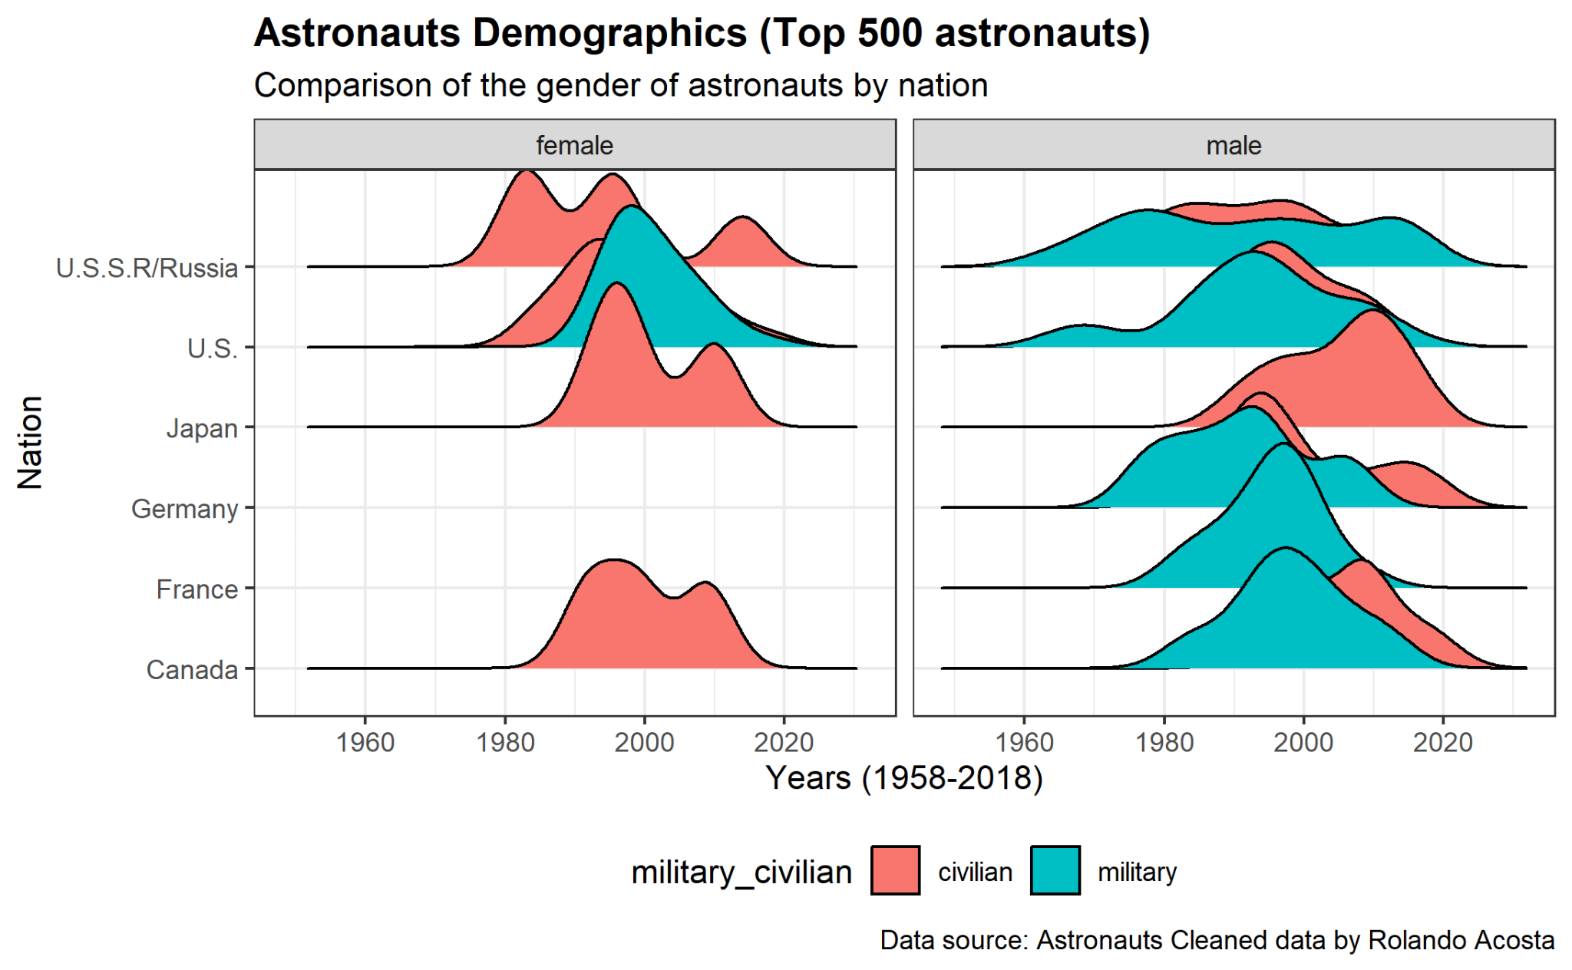
Year of the mission v.s. nationality
Diagram shows…
A peak in total hours of flights performed with a crew including females in these five missions seen in 1996 and 2003.
Code:
austronauts %>%
filter(nationality %in% countries) %>%
ggplot(aes(x=year_of_mission,y=nationality,
fill=nationality)) +
geom_density_ridges()+
theme(legend.position = "none")+
facet_wrap(~sex)

Slide 13
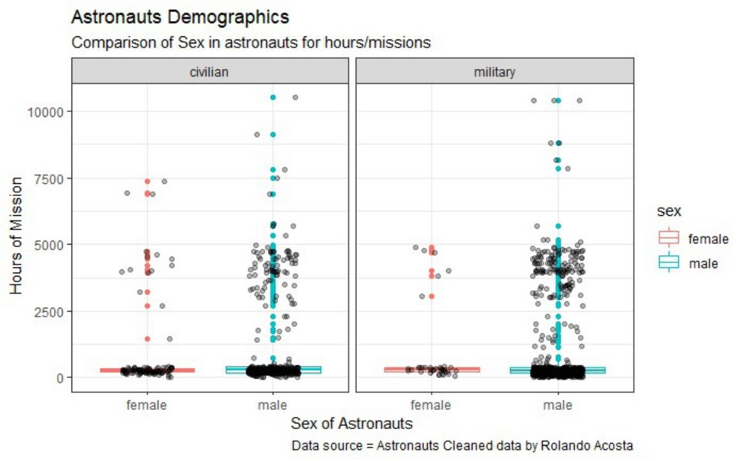
Sex of astronaut v.s. hours of mission
Diagram shows…
how the data from the civilian males are very similar to the military but still are less in minority in mission hours by a small difference.
how the civilian female astronauts have more hours in mission then the females with a military background.
Code:
austronauts %>%
ggplot(aes(x=sex, y=hours_mission, color=sex))+
geom_boxplot(outlier.shape = NA, width=0.5)+
geom_jitter(width=0.2, alpha=0.5)+
facet_wrap(~military_civilian)+
theme(legend.position="none",
panel.border = element_blank(),
panel.spacing.x = unit(0,"line"))

Slide 14
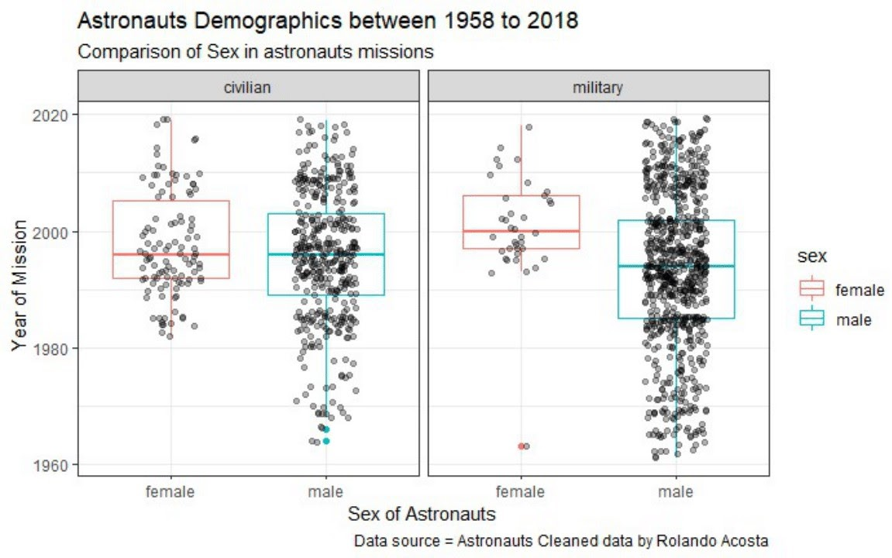
Demographic profile of astronauts
Diagram shows…
how the recruitment method has changed drastically by showing us the amount of civilian and military astronauts performing missions during the past 60 years.
how the astronauts are being recruited not only for their military background but also for their scientific knowledge and preparation for the mission in more recent times.

Slide 15
Conclusion
The aim of this research was to explore changes in both the operational characteristics and the demographic profile of astronauts over the past 60 years of space missions (1959-2018). From this analysis, the team reached the following conclusions:
Only 10% of the total 1,278 spaceflights analyzed in this sample were performed by women.
The U.S. space program far leads its Soviet counterpart in total flight hours performed by female crew.
A significant reduction in the total hours of flights performed by crew with military experience over the years can be observed, which coincides with an increase in the total number of flight hours performed by crew with a scientific background.
Since the early 1980’s and coinciding with the MIR and the Space Shuttle programs, the number of flight hours per year has increased vertiginously.

